Slide 1
Lab 9
Acquisition of Volatile Memory

Slide 2
Volatile Evidence
Volatile evidence is a potential source that is comprised of data in a state of change.
Data is lost (or begins to be lost) when power is removed.
Data in active physical memory
Logical memory (lost on orderly shutdown)

Slide 3
Live Collection
Volatile evidence can only be gathered while a system is running.
However, there may be other situations where live collection is required, such as when a shutdown of a system is not possible with causing financial loss.
The idea is to do the least intrusive collection if it’s worth displacing a few bits to get good evidence.

Slide 4
Live Collection
REMEMBER: By running tools on a live system you will load them into memory – creating (at least) one process which might overwrite evidence.
AT WORST - memory management allocates data in main memory to overwrite evidence in unallocated space.
AT BEST – your acquisition tools leave traces that can be confused with signs of intrusion.
On Windows machines even moving the mouse accesses dynamic hives.

Slide 5
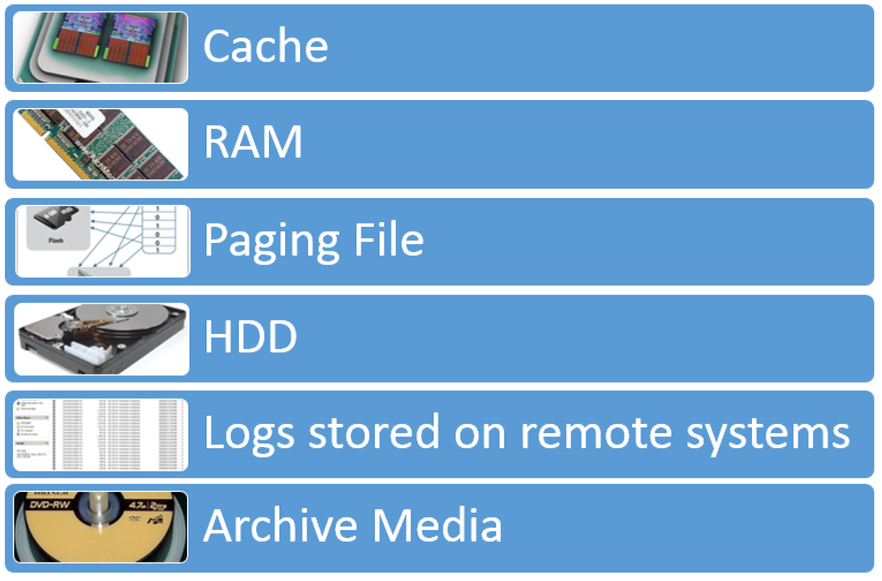

Slide 6
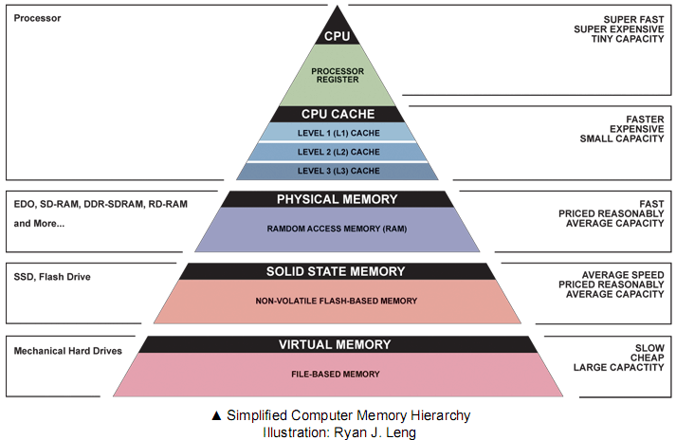

Slide 7
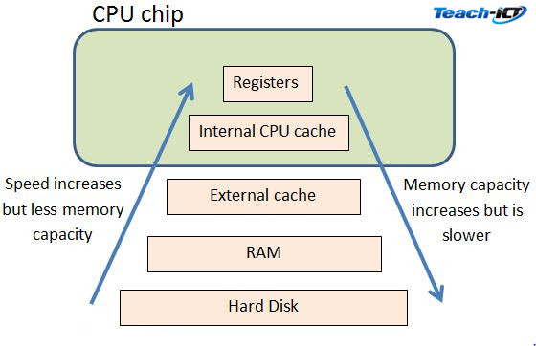
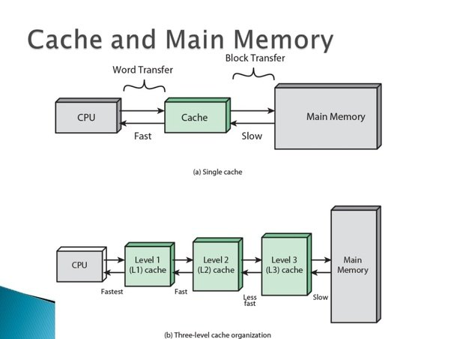

Slide 8
Live Collection Process
First of all, follow your scene response procedures. This process supplements that one, does not override it. You should already have your scene report started, your search grid established, and everything else going. Everything after this applied ONLY to the live collection process AFTER the scene has been established.
Photograph the screen of the running system to document its state.
Note the operating system running.

Slide 9
Live Collection Process
Establish an audit trail. Begin by collecting system date, time, uptime, and establishing a command history (a list of commands you run as you run them, and the outcome – you can press F7 in cmd.exe to see a list for verification purposes.
Note any discrepancies between the system date/time and the actual date/time.

Slide 10
Live Collection Process
As you execute each tool or command, generate the date and time for the audit trail. Document all collection activities.
Collect all the volatile evidence and network info. Be sure to generate and record hash values for all evidence wherever possible.
Dump RAM and all other digital evidence to a removable drive (sanitized)
Check for full or partial disk encryption
When you end the collection, generate the date and time, verify the command history.
Determine the seizure method for the hardware or disk evidence.

Slide 11
Live Collection Process
This is one approach – how to proceed with a live collection is situational:
Unless you are actively tracking an ongoing attack, the first step is to disconnect the system from the network (wireless and wired.) This will stop exfiltration or additional external damage to evidence. Collect network information BEFORE you do this.
Otherwise run a sniffer to capture traffic.
Some investigators rely on immutable media – DVDs/CDs with collection tools. Others use USB drives (a place to run/save)
Evidence collected should have their hash values calculated in situ so they can be verified later.

Slide 12
Live Collection Tools
Forensic Analysis Toolkit (FATKit)
Helix Live
CAINE (Computer Aided Investigative Environment)
DEFT
ElcomSoft
Memoryze
KnTDD
Nigilant
The big names: EnCase, FTK Suite, ProDiscover, COFFEE,
Loose tools like LiveWire (no longer around), WireShark, Knoppix, Netcat, any other utilities than can be used to gather information. Mimikatz can be used to scrape cached password hashes.
For Windows acquisition, it’s not a bad idea to have Windows versions of common Linux tools, like dd, md5sum, etc.
For loose tools, create batch files (to ensure consistent command running and eliminate “fat-fingering”) and place those and the tools on write-protected or immutable media. PowerShell is even better, but make sure your cmdlets are version-agnostic.
Keep in mind that programs that require the acceptance of an EULA will write a reg key to record your acceptance. Be aware of this when you do your analysis.

Slide 13
Legal Considerations
If you recall our unit on warrants and subpoenas, it is necessary to ensure search authority before conducting the search. The warrant must have specificity to be valid, so ensure that any warrant or search contract contains provisions for:
The electronic documentation and preservation of the STATE of the computer, network, and/or electronic storage media.
Conducting preview screenings (surveys) of computer data storage or computer/network state for relevant contraband/evidence and the usage of data recovery tools.

Slide 14
What Volatile Evidence Contains
To decide whether or not an attempt at a live acquisition is worth it, you need to know what you might find in volatile evidence:
IO functions – For example, the keyboard buffer resides in memory, giving indications of keypresses.
Passwords – It’s possible that active running processes that have had passwords passed hold them in memory for continued authentication (Windows does this.)
In the case of RootKits (2nd gen, dll lib loads) RAM might have clues on the origins of the malware.
Running programs, cached images, text (low-level code, instant messages, etc.)
Users logged into the system, what they are doing, and devices attached to the system

Slide 15
What Volatile Evidence Contains
Some devices ONLY contain volatile evidence.
TAILS – and other live OS save nothing to disk, but reside only in memory.
Many varieties of routers and other network devices lack persistent memory.
Cell phones – obviously have persistent storage, but most user data is only in memory while there is power, and swapped around with disk files.

Slide 16
What to Collect
Raw memory – Volatility is the best tool for live cap of RAM, but many other utilities are capable – FTK, for example.
Current sessions. Users logged into the system create a session (processes running under a user’s context.) PsLoggedOn is a quick way to get a list in Windows.
Clipboard contents
Running processes and dependencies – utilities like ProcessExplorer/ProcMon specialize in this. (ProcMon combined Regmon and Filemon)

Slide 17
What to Collect
Network info – ipconfig /all for IP, config, etc. Running a sniffer to capture traffic is done during a live analysis, when you believe an attacker is actively accessing a system.
System date and time (important to establish a timeline later in the reconstruction process.) time /t & date /t
Scheduled tasks. Schedule tasks are automated processes set to run on various triggers. SchTasks displays from command line.
Registry and file access (see ProcMon)

Slide 18
Access has Rewards
Having direct access to a running system also allows you to gather intel / evidence directly from the system.
Common commands you might use for normal troubleshooting / operating purposes can glean relevant data.
The PSTools suite is a common toolset that can be very useful with direct access to a machine.

Slide 19
What to Collect
Windows information to collect:
Net accounts – Account policy settings
Net file – Files open by remote users
Net sessions – Remote connections
Net share – Local accessible shares
Net start – Services and their status
Net use – Remote shares the system is connected
Net user – All user accounts
Net view – Computers in the local domain
Route print – System current route tables
Arp –a – ARP tables (MAC to IP mapping)
Netstat –anr – connection and listening ports
Netstat –noa – Active connections
Tasklist – list of tasks (combined with findstr and the PID from above command.)
Nbtstat –c – NetBIOS name cache with remote machine names and IPs

Slide 20
What to Collect
Windows information to collect:
Nbtstat –c – NetBIOS name cache with remote machine names and IPs
Pslist – Process info
Psinfo – System info
Systeminfo – System info, uptime, etc.
Psloggedon – Users sessions
The Sysinternals suite in general is ALWAYS good to have on a disk.
LogonSessions – Active logons
Paste – To dump clipboard contents
Handle – Displays the various handles processes have open.
Listdlls – Displays loaded DLLs
Doskey /history – command line history

Slide 21
Some Problematic RegKeys
Reg Keys aren’t really volatile evidence, but there are some you should be aware of when you do a live collection because they might influence how you proceed.
ClearPageFileAtShutdown – Instructs the OS to dump the page file when the system is shutdown. If you want to preserve that and this key is present, you might yank the power rather than issue a shutdown command.
DisableLastAccess – By default Windows keeps track of when a file was last opened, but this reg key can turn that off. If you are doing a live acquisition and see LastAccess dates and this reg key, it means the next reboot will wipe those dates.

Slide 22
Protected Storage
\Protected Storage\UserName\Identification\INETCOMM Server Passwords
Contains usernames and passwords for all mailboxes known to Outlook.
\Protected Storage\UserName\WininetCacheCredentials\WininetCacheCredentials
Contains usernames and passwords for all password-protected web resources saved by Internet Explorer.
\Protected Storage\UserName\IdentityMgr\IdentitiesPass
Contains passwords for Outlook Identities. Passwords are offset by 4 bytes against the beginning of the record (this causes them to be invisible in the Demo version, sorry).
\Protected Storage\UserName\Internet Explorer\Internet Explorer
Internet Explorer web form autocomplete data & passwords.

Slide 23
Most Important Tip for Live Acquisitions
We’ve said it before: TEST YOUR TOOLS. You should NEVER arrive at the scene and not be 100% confident in your tools or your process.
This is especially true of live acquisitions.
If you are using scripts to automate your collection, test them over and over one many different systems before using them in the field. Build a clean system, image it, run your tools, image it again and compare hashes. If they are different, examine the systems for those changes. There should be no guesswork involved.

